Slide 1
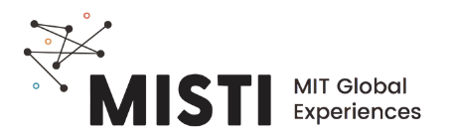
Polymer Fibers

Slide 2
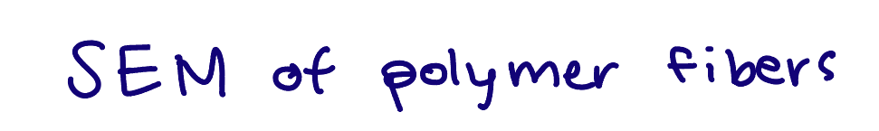
Fiber structure
Much looooooonger than they are wide
Have many aligned chains - high crystalline or semicrystalline content
Anisotropic- properties depend on the direction or angle measured
High strength
Low strength
Pham et al., Tissue Engineering, 2006.

Slide 3
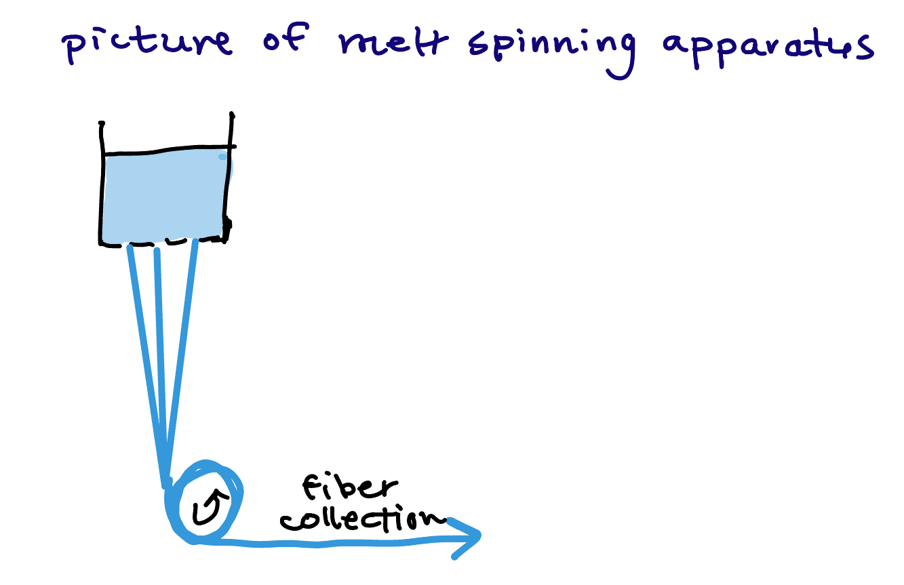
Production - melt spinning
Most synthetic fibers are made by “spinning”, or forcing a material through a spinneret. It’s like a shower head!
Melt spinning is typical for common polymers such as polyester, nylon, and polypropylene
https://www.youtube.com/watch?v=cn6K1m7yH0I

Slide 4
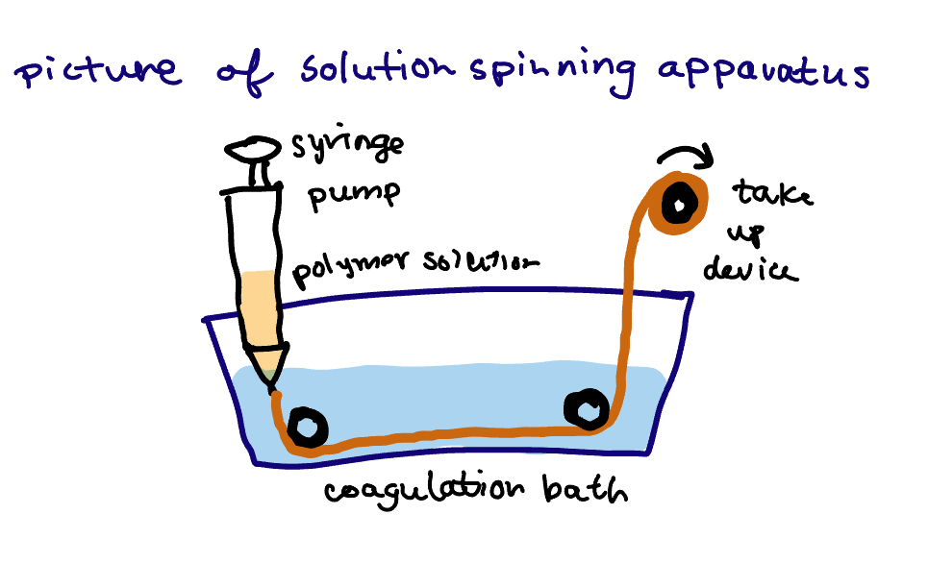
Production - solution spinning
Polymers are dissolved in a liquid solvent
The precipitate, or solidify, when injected into the coagulation bath.
https://www.youtube.com/watch?v=x0VFeMTSIb4
Notes:
https://www.researchgate.net/figure/Common-systems-of-A-wet-spinning-and-B-dry-jet-wet-spinning-In-dry-jet-wet_fig3_325942311

Slide 5
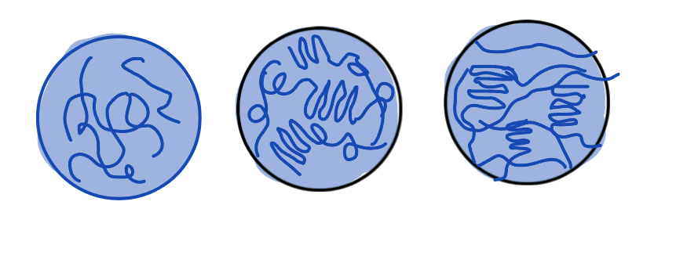
Production - drawing
An important step after spinning
Stretching or drawing pulls on the fiber to align the polymer chains to improve strength and increase crystallinity.
https://www.youtube.com/watch?v=faeQSTpPh9w (first 30 sec)
Molten
As-spun
Drawn
Pegoretti et al., Handbook of Properties of Textile and Technical Fibres, 2018.

Slide 6
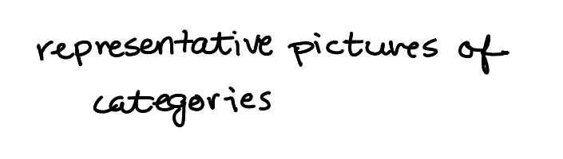
Fiber applications
Strengthening composites
Clothing
Textiles
Notes:
https://www.wetrytires.com/cords-showing-on-tires/

